Slide 1
Beyond just-policy transition:
Practitioner Experiences
in the Conceptual and Practical
Transition to the new CA BILA and BTPEs
CCTE SPAN 2023

Slide 2
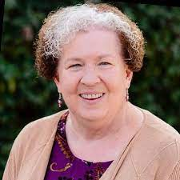
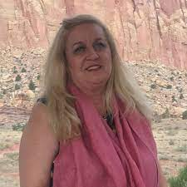
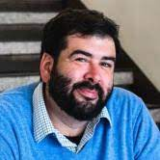
CABTE California Association for Bilingual Teacher Educators
Dr. Sharon Merritt
Sharon.Merritt@fresno.edu
Dr. Clara Amador-Lankster
camadorl@nu.edu
Dr. Eduardo R. Muñoz-Muñoz
eduardo.munoz-munoz@sjsu.edu

Slide 3
Objectives
Consider the critical nexus of policy and practice in bilingual education policy in CA
Discuss issues of implementation and prospective implications for the bilingual teacher pipeline.
Entertain possibilities for future bilingual education policy in CA

Slide 4
Reframing Culture: From Essentialist Concepts to Human Transnational Experience
Sharon Merritt
Fresno Pacific University
CABTE Past President

Slide 5
Changing Cultural Paradigms
BILA Standards 2008, Standard 5:
The Culture of Emphasis: An etic perspective
5.1: Candidates demonstrate knowledge of the traditions, roles, status, and communication patterns of the culture of emphasis as experienced in the country or countries of origin and in the United States.
5.2: Candidates demonstrate understanding of crosscultural, intercultural and intracultural relationships and interactions, as well as contributions of the culture of emphasis in California and the United States.
5.3: Candidates demonstrate knowledge of major historical events, political, economic, religious, and educational factors that influence the socialization and acculturation experiences of the target groups in the California and the U.S.
5.4: Candidates demonstrate knowledge of the country/countries of origin, including geographic barriers, demographic and linguistic patterns, and the ways in which these affect trends of migration, immigration and settlement in the United States.

Slide 6
An aside: CSET Spanish V
By law, can be used in combination with other CSETs to fulfill the “culture” requirement of the Bilingual Authorization directly through the CTC.
Reinforces the concepts of “culture of emphasis,” “country or countries of origin,” “target groups”
Test prep tools make clear the focus of the test: discrete, random bits of knowledge about history and cultural attitudes and practices

Slide 7
Changing Cultural Paradigms 2
2021 BTPEs related to previous Standard 5: the emic perspective
BTPE 1.1 : Beginning bilingual teachers apply their knowledge of students, students’ backgrounds, assets, learning needs, and goals using the state-adopted academic content standards to engage and motivate students in developmentally, culturally, and linguistically appropriate learning activities.
BTPE 1.3: Beginning bilingual teachers support all students in learning through respecting the dynamic nature of language change, students’ own language use, cultural practice, beliefs, traditions, and values, and funds of knowledge.
BTPE 1.4: Beginning bilingual teachers recognize students’ transnational educational and cultural experiences and ongoing transnational participation of their communities and apply these understandings within culturally and linguistically appropriate learning activities and engagement with families.
BTPE 6.1: Beginning bilingual teachers demonstrate awareness of historical bias and practices of institutional racism and identify and mitigate these biases and practices in their own thinking, instructional planning, and interactions with students, colleagues, family, and community members to support and increase student biliteracy levels.
BTPE 6.3: Beginning bilingual teachers demonstrate awareness of organizations committed to the advancement of bilingual education.
BTPE 6.6: Beginning bilingual teachers recognize the negative effects on students of stereotyping, lack of valuing language varieties/dialects used by students, families, and communities, and lack of valuing the diversity, dimensionality of language.

Slide 8
Redefinition of “culture” in BTPEs
“Culture” framed in local (students, families, communities) and transnational terms : ongoing experiences of transnationalism – seeing and using both as assets in classroom
Clearer emphasis on linguistic and cultural respect as part of cultural knowledge: “the dynamic nature of language change, students’ own language use, cultural practice, beliefs, traditions, and values, and funds of knowledge.”
Focus on understanding linguistic complexity and valuing language varieties, diversity or dimensionality
History focused on bias and institutional racism/linguisism and efforts to resist: learning about the organizations committed to bilingual education and justice, in the past and now

Slide 9
Recent Resources for Course Adaptations
Ada, A. F.; Campoy, F. I.; & Baker, C. (2017) Guía para padres y maestros de niños bilingües. 2a edición. Multilingual Matters.
Flores, N; Tseng, A.; & Subtirelu, N (Eds.). (2021). Bilingualism for all?: Raciolinguistic perspectives on dual language education in the United States. Multilingual Matters.
Gandara, P. & Jensen, B. (Eds.) (2021). The students we share: Preparing US and Mexican educators for our transnational future. SUNY.
Garcia, O. & Kleifgen, J. A. (2018). Educating emergent bilinguals: Policies, programs, and practices for English Learners. 2nd Edition. Teachers College.

Slide 10
Recent Resources for Course Adaptations, cont.
Jensen, B. & Sawyer, A. (2013). Regarding educación: Mexican-American schooling, immigration, and bi-national improvement. Teachers College.
Meyers, S. (2014). Del otro lado: Literacy and migration across the U.S.-Mexico border. Souther Illinois Univ.
Olsen, L. (2021). A legacy of courage and activism: Stories from the movement for educational access and equity for English Learners in California. Californians Together.
Orellana, M. F. (2009). Translating childhoods: Immigrant youth, language, and culture. Rutgers University.
Portes, P. R.; Salas, S.; Baquedano-López, P.; & Mellom, P. J.(Eds.) (2014). U.S. Latinos and education policy: Research-based directions for change. Routledge.
Among many others!

Slide 11
Aligning structures, deepening practice: Seizing the opportunity as a community of practice
Eduardo R. Muñoz-Muñoz
San José State University
CABTE President

Slide 12
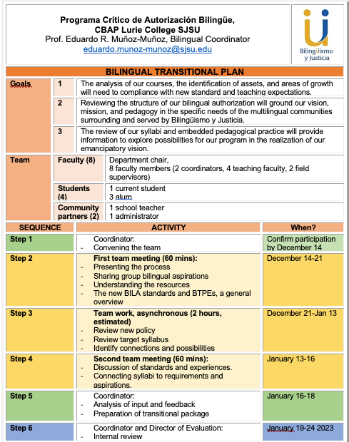
Goals?

Slide 14
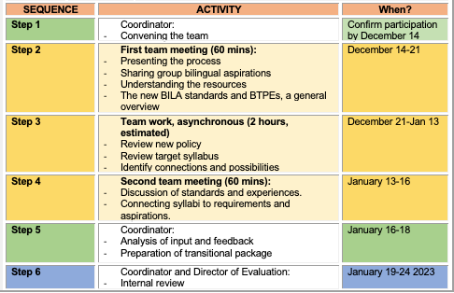

Slide 15
Implications
What is beyond the policy?
How do pathways serve different populations?
How do we coordination implementation?
What is the field experience like?

Slide 16
Advocating for a new legitimacy of languages and language use in the dual language classroom
Clara Amador-Lankster
National University
CABTE Board member

Slide 18
Discussion

Slide 19
CABTE California Association for Bilingual Teacher Educators
Dr. Sharon Merritt
Sharon.Merritt@fresno.edu
Dr. Clara Amador-Lankster
camadorl@nu.edu
Dr. Eduardo R. Muñoz-Muñoz
eduardo.munoz-munoz@sjsu.edu

